Slide 1

ENV 107 Introduction to Environmental Science Sustainable Agriculture North South University

Slide 2
Agriculture
Agriculture refers to the production of goods (food, fiber, etc.) through the growing of plants, animals and other life forms. It is the art and science of farming.
People obtain food from cultivated plants and domesticated animals.
Historically, humans have depended on three systems for their food supply:
(1) croplands (mostly for producing grains, which provide about 76% of the world's food),
(2) rangelands (for producing meat mostly from grazing livestock, which supply about 17% of the world's food), and
(3) oceanic fisheries (which supply about 7% of the world's food).

Slide 3
Characteristics of Bangladesh Agriculture
Cropping intensity 179%
Irrigated land 56%
Surface water:21% groundwater:79%
Land-man ratio: .06 ha
Mainly subsistence farming
Inadequate agro-processing
Non-mechanized farming
Fragmented land/plots
Dependence largely on nature

Slide 4
Some Challenges
Rapid shrinkage of agricultural land @1% per year
Population growth @1.48% per year
Climate change and variations
Rapid urbanization growth @12% per year
Agricultural research and education (manpower shortage, updating course curriculum)
Technology generation (needs expertise, time and money)
Technology dissemination (needs expertise, time, logistics support)
Alternate livelihoods/rehabilitation program
Inadequate value addition/food processing

Slide 5
Challenges continued…
Climate change adaptation & mitigation
Developing stress tolerant varieties
Transferring updated information and technologies to the field
Attaining irrigation efficiency
Regaining soil fertility and natural ingredients
Research-extension-farmer-market linkage
Shortage of Agricultural labor at peak seasons

Slide 6
Agriculture Driven Major Environmental Problems
Major environmental problems the result from agriculture include
Deforestation,
Desertification,
Soil Erosion,
Overgrazing,
Degradation Of Water Resources,
Salinization,
Accumulation Of Toxic Organic Compounds, And
Water pollution including eutrophication

Slide 7
What is Sustainable Agriculture?
“Sustainable agriculture means an integrated system of plant and animal production practices having a site-specific application that over the long term will:
Satisfy human food and fiber needs.
Enhance environmental quality and the natural resource base upon which the agricultural economy depends.
Make the most efficient use of nonrenewable resources and on-farm resources and integrate, where appropriate, natural biological cycles and controls.
Sustain the economic viability of farm operations.
Enhance the quality of life for farmers and society as a whole.”

Slide 8
Differences between the Contemporary and Sustainable Types of Agriculture
Contemporary Agriculture | Sustainable Agriculture
System simplification/monoculture Specialized agriculture (economically vulnerable) Soil is considered just as a medium Feed the plant directly, not the soil Linear flow of nutrients or energy | System of production diverse not restricted by monoculture of crops Recycling of nutrient pool for crop Feed and nurture the soil, not the crop Holistic approach to farm productivity

Slide 9
Positive Aspects which Enhance Modern Agriculture
High yield / high and fast returns / profit oriented
Increased mechanization
Scope for intensive cropping
Better compatibility through genetic homogeneity in inter/mixed cropping
New varieties of plant breed (pest/disease tolerant)
Maximum utilization of land and water
Meeting the need of sufficient and fast food production

Slide 10
Negative Aspects of Modern Agriculture
Short term benefit, operates law of diminishing returns
Depletion of nutritional base of the soil, water and atmosphere quality
Environmental pollution due to use of chemicals (water, soil, environmental)
Health hazards due to entry of pesticides, toxins, antibiotics, heavy metals in to food chain
High cost of production
Increasing dependency on external inputs
Poor quality of products
Operates against principles of nature and ecology
Natural parasites, predators and beneficial insects are adversely affected and totally disappear over a period of time

Slide 11
Positive aspects of Sustainable Agriculture
Affordability by any farmer
No sophisticated/imported and special technology is necessary
Environmental conservation and protection
Healthy atmosphere/healthy food
Prevent/avoid ecological degradation
Increasing stability and status of soil fertility
Security more through higher levels of disease and pest resistance
Recycling of nutrients
Substance of soil fertility through organic recycling
Diversity
Inter dependency
Efficient use of natural resources
Self sustaining

Slide 12
Elements of Sustainable Agriculture
Soil Conservation
Crop diversity
Nutrient management
Integrated Pest Management (IPM)
Water quality & water conservation
Agro forestry
Marketing

Slide 13
Soil Erosion
Soil erosion is one form of soil degradation and it is a naturally occurring process on all land.
The agents of soil erosion are water and wind, each contributing a significant amount of soil loss each year.
Soil erosion may be a slow process that continues relatively unnoticed, or it may occur at an alarming rate causing serious loss of topsoil.
The loss of soil from farmland may be reflected in reduced crop production potential, lower surface water quality and damaged drainage networks.
Soil erosion potential is increased if the soil has no or very little vegetative cover of plants and/or crop residues.

Slide 14
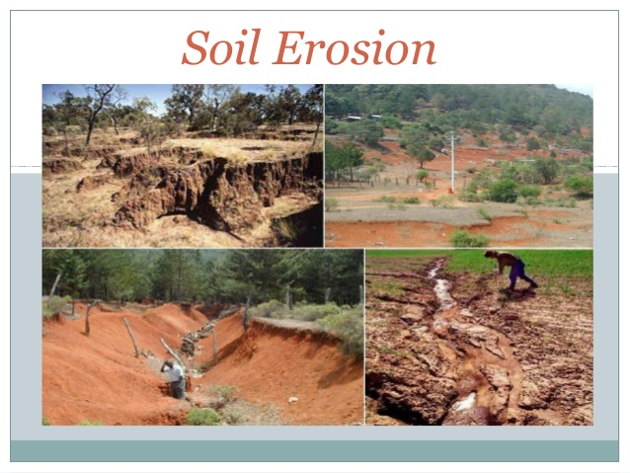

Slide 15
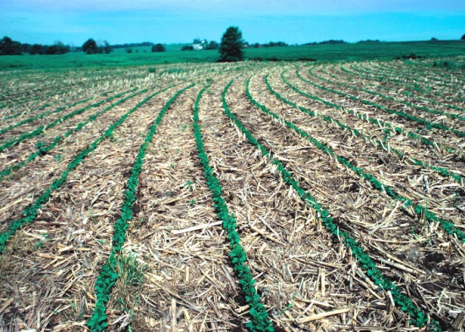
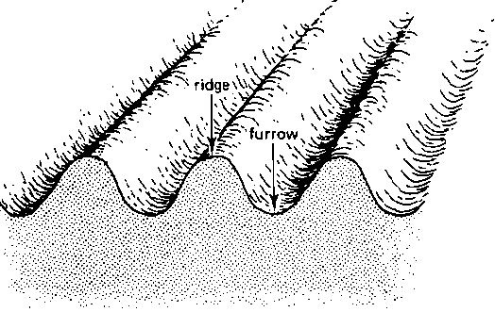
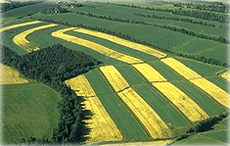
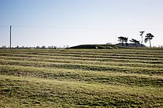
Arable land Management
Vegetative cover: Vegetative cover refers to as trees, perennial bunchgrasses and grasslands, legumes, and shrubs
Strip cropping mulching
Ridges/furrows
Water ways with vegetative cover and gully plugging [Gully (drain) control is very essential to prevent its extension and further destruction of cultivated lands and grasslands. The sloping sides are planted with grass and trees. Suitable temporary and permanent structures such as check dams, overflow dams, drop structures are also provided]

Slide 16
Plant Nutrients
Sixteen chemical elements are known to be important to a plant's growth and survival. The sixteen chemical elements are divided into two main groups: non-mineral and mineral.
Non-Mineral Nutrients are hydrogen (H), oxygen (O), & carbon (C).
Mineral nutrients:
The macronutrients are nitrogen (N), phosphorus (P), potassium (K), calcium (Ca), magnesium (Mg), and sulfur (S). Plants use these mineral nutrients in large amounts for their growth and survival.
The micronutrients are boron (B), copper (Cu), iron (Fe), chloride (Cl), manganese (Mn), molybdenum (Mo) and zinc (Zn). Plants use these minral nutrients in less amounts.

Slide 17
Pesticides
A pesticide is any chemical used to kill or control the population of unwanted fungi, animals or plants (weeds), often called pests.
Problems with pesticides use
Reduction in one target species reduces competition with a second,
The pest develops resistance to the pesticides which favors those in the population with a greater immunity to the chemical.

Slide 18
Impact of Pesticides on Organisms
Bioaccumulation
Accumulation in the bodies of animals without killing the animals. This accumulation process is called bioaccumulation.
Biological amplification
When a carnivore eats the affected animals, these toxins are concentrated, causing death or diseases of the carnivores at the higher levels even though lower tropic level organisms are not injured.
This phenomenon of increasing levels of substances in the bodies of higher trophic level organisms is known as biological amplification.

Slide 19
What is IPM?
Integrated Pest Management (IPM) is a system that, in the context of prevailing environment and population dynamics of the pest species, utilizes all appropriate techniques and methods in as compatible a manner as possible and maintains pest populations at levels below Economic Threshold Level (ETL)
-FAO, 1967

Slide 20
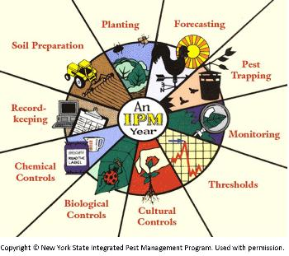

Slide 21
Advantages of IPM
We often hear the question “what are the advantages of IPM?”. Think of this:
More regular crop quality and quantity
Healthier plants
Reduced contamination of the environment
Reduced use of pesticides
Reduced input costs
Better use of natural resources
Reduced contamination of the crop with chemical residues
Reduced risk of farmers from contamination with chemicals

Slide 22
Irrigation Water Management
Irrigation can also be defined as the supply of water to crops by artificial means, designed to permit farming in arid regions and to offset drought in semiarid and semi humid regions.
To add water to the soil for supplying the moisture essential for plant growth
To provide protection to crops against short duration droughts
To cool the soil and atmosphere, thereby making more favorable environment for plant growth
To wash out or dilute salts in the soil
To reduce the hazards of soil piping, and
To soften tillage pans

Slide 23
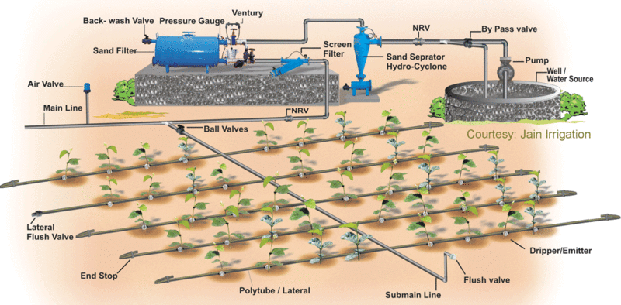
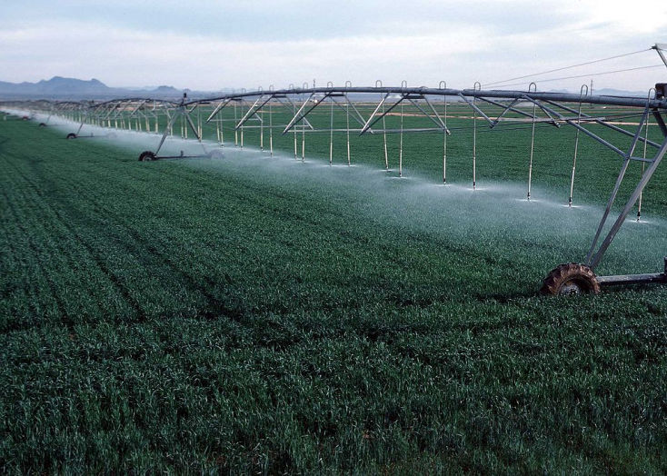
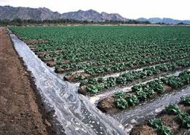
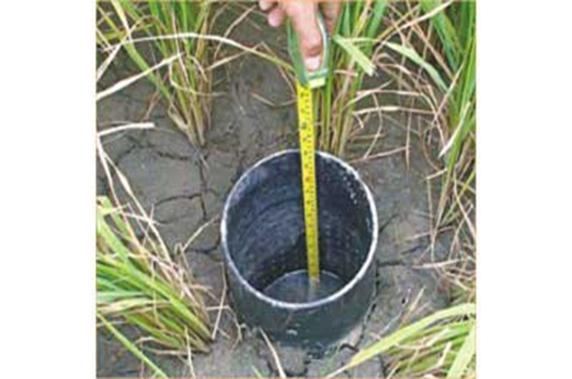
Different method of Irrigation
The four methods of irrigation are:
Surface
Sprinkler
Drip/trickle
Subsurface

